Slide 1


并行硬件和并行软件
任课教师：王桢

Slide 2
课程内容
参考资料：
并行程序设计导论，Peter S Pacheco, 机械工业出版社， 2016
CHAPTER 2 Parallel Hardware and Parallel Software

Slide 3


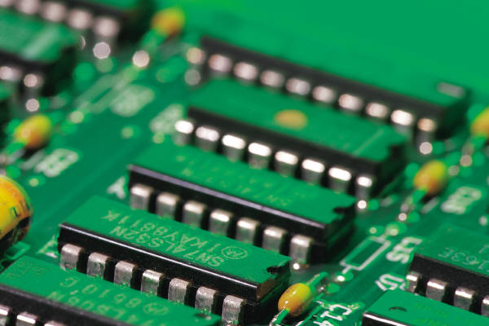
Some background

Slide 4


Serial hardware and software
programs
input
Computer runs one
program at a time.
output

Slide 5
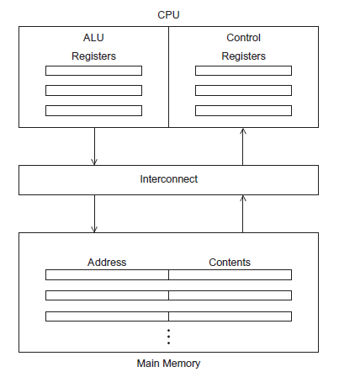
The von Neumann Architecture

Slide 6
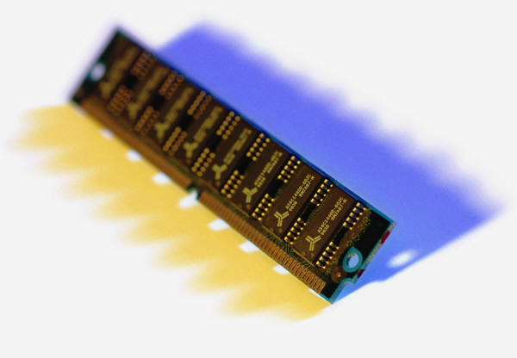
Main memory
This is a collection of locations, each of which is capable of storing both instructions and data.
Every location consists of an address, which is used to access the location, and the contents of the location.

Slide 7

Central processing unit (CPU)
Divided into two parts.
Control unit - responsible for deciding which instruction in a program should be executed. (the boss)
Arithmetic and logic unit (ALU) - responsible for executing the actual instructions. (the worker)
add 2+2

Slide 8
Key terms
Register – very fast storage, part of the CPU.
Program counter – stores address of the next instruction to be executed.
Bus – wires and hardware that connects the CPU and memory.

Slide 9
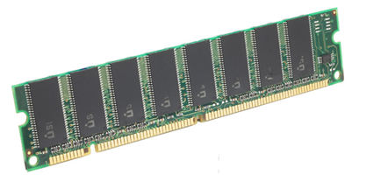

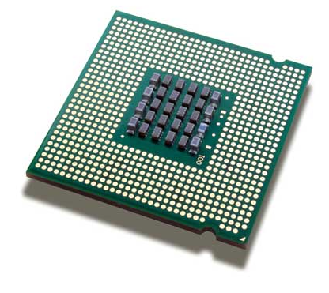
memory
fetch/read
CPU

Slide 10

memory
write/store
CPU

Slide 11


von Neumann bottleneck

Slide 12
An operating system “process”
An instance of a computer program that is being executed.
Components of a process:
The executable machine language program.
A block of memory.
Descriptors of resources the OS has allocated to the process.
Security information.
Information about the state of the process.

Slide 13
Multitasking
Gives the illusion that a single processor system is running multiple programs simultaneously.
Each process takes turns running. (time slice)
After its time is up, it waits until it has a turn again.

Slide 14
Threading
Threads are contained within processes.
They allow programmers to divide their programs into (more or less) independent tasks.
The hope is that when one thread blocks because it is waiting on a resource, another will have work to do and can run.

Slide 15
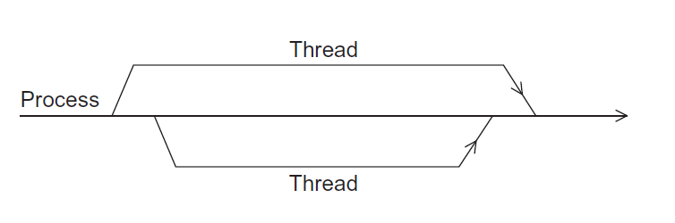
A process and two threads
the “master” thread
terminating a thread
Is called joining
starting a thread
Is called forking

Slide 16

Modifications to the von neumann model

Slide 17

Basics of caching
A collection of memory locations that can be accessed in less time than some other memory locations.
A CPU cache is typically located on the same chip, or one that can be accessed much faster than ordinary memory.

Slide 18
Principle of locality
Accessing one location is followed by an access of a nearby location.
Spatial locality – accessing a nearby location.
Temporal locality – accessing in the near future.

Slide 19
Principle of locality
float z[1000];
…
sum = 0.0;
for (i = 0; i < 1000; i++)
sum += z[i];

Slide 20
Levels of Cache
smallest & fastest
L1
L2
L3
largest & slowest

Slide 21
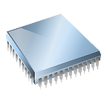
Cache hit
fetch x
L1
x sum
L2
y z total
L3
A[ ] radius r1 center

Slide 22
Cache miss
fetch x
x
main
memory
L1
y sum
L2
r1 z total
L3
A[ ] radius center

Slide 23
Issues with cache
When a CPU writes data to cache, the value in cache may be inconsistent with the value in main memory.
Write-through caches handle this by updating the data in main memory at the time it is written to cache.
Write-back caches mark data in the cache as dirty. When the cache line is replaced by a new cache line from memory, the dirty line is written to memory.

Slide 24
Cache mappings
Full associative – a new line can be placed at any location in the cache.
Direct mapped – each cache line has a unique location in the cache to which it will be assigned.
n-way set associative – each cache line can be placed in one of n different locations in the cache.

Slide 25
n-way set associative
When more than one line in memory can be mapped to several different locations in cache
we also need to be able to decide which line should be replaced or evicted.
x

Slide 26
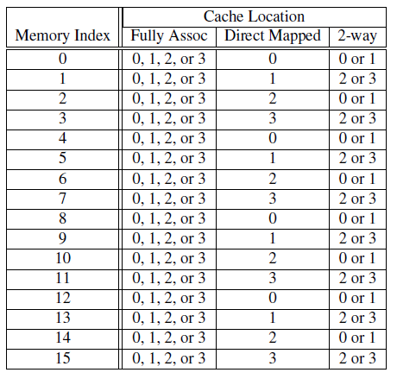
Example
Table 2.1: Assignments of a 16-line main memory to a 4-line cache

Slide 27
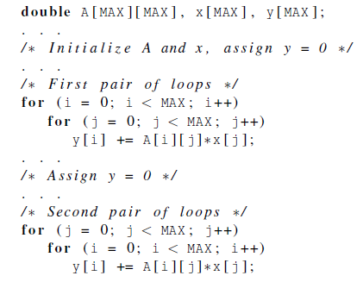
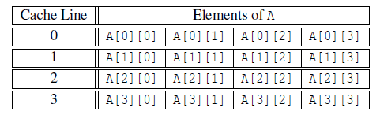
Caches and programs

Slide 28
Virtual memory (1)
If we run a very large program or a program that accesses very large data sets, all of the instructions and data may not fit into main memory.
Virtual memory functions as a cache for secondary storage.
Using virtual address

Slide 29
Virtual memory (2)
It exploits the principle of spatial and temporal locality.
It only keeps the active parts of running programs in main memory.

Slide 30
Virtual memory (3)
Swap space - those parts that are idle are kept in a block of secondary storage.
Pages – blocks of data and instructions.
Usually these are relatively large.
Most systems have a fixed page size that
currently ranges from 4 to 16 kilobytes.
More details

Slide 31
Virtual memory (4)
program A
main memory
program B
program C

Slide 32
Virtual page numbers
When a program is compiled, its pages are assigned virtual page numbers.
When the program is run, a table is created that maps the virtual page numbers to physical addresses.
A page table is used to translate the virtual address into a physical address.
More details

Slide 33
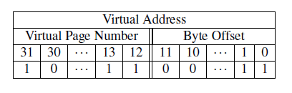
Page table
Table 2.2: Virtual Address Divided into Virtual Page Number and Byte Offset

Slide 34
Translation-lookaside buffer (TLB)
Using a page table has the potential to significantly increase each program’s overall run-time.
A special address translation cache in the processor.

Slide 35
Translation-lookaside buffer (2)
It caches a small number of entries (typically 16–512) from the page table in very fast memory.
Page fault – attempting to access a valid physical address for a page in the page table but the page is only stored on disk.

Slide 36
Instruction Level Parallelism (ILP)
Attempts to improve processor performance by having multiple processor components or functional units simultaneously executing instructions.

Slide 37
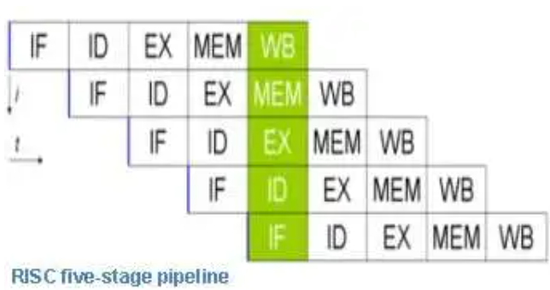
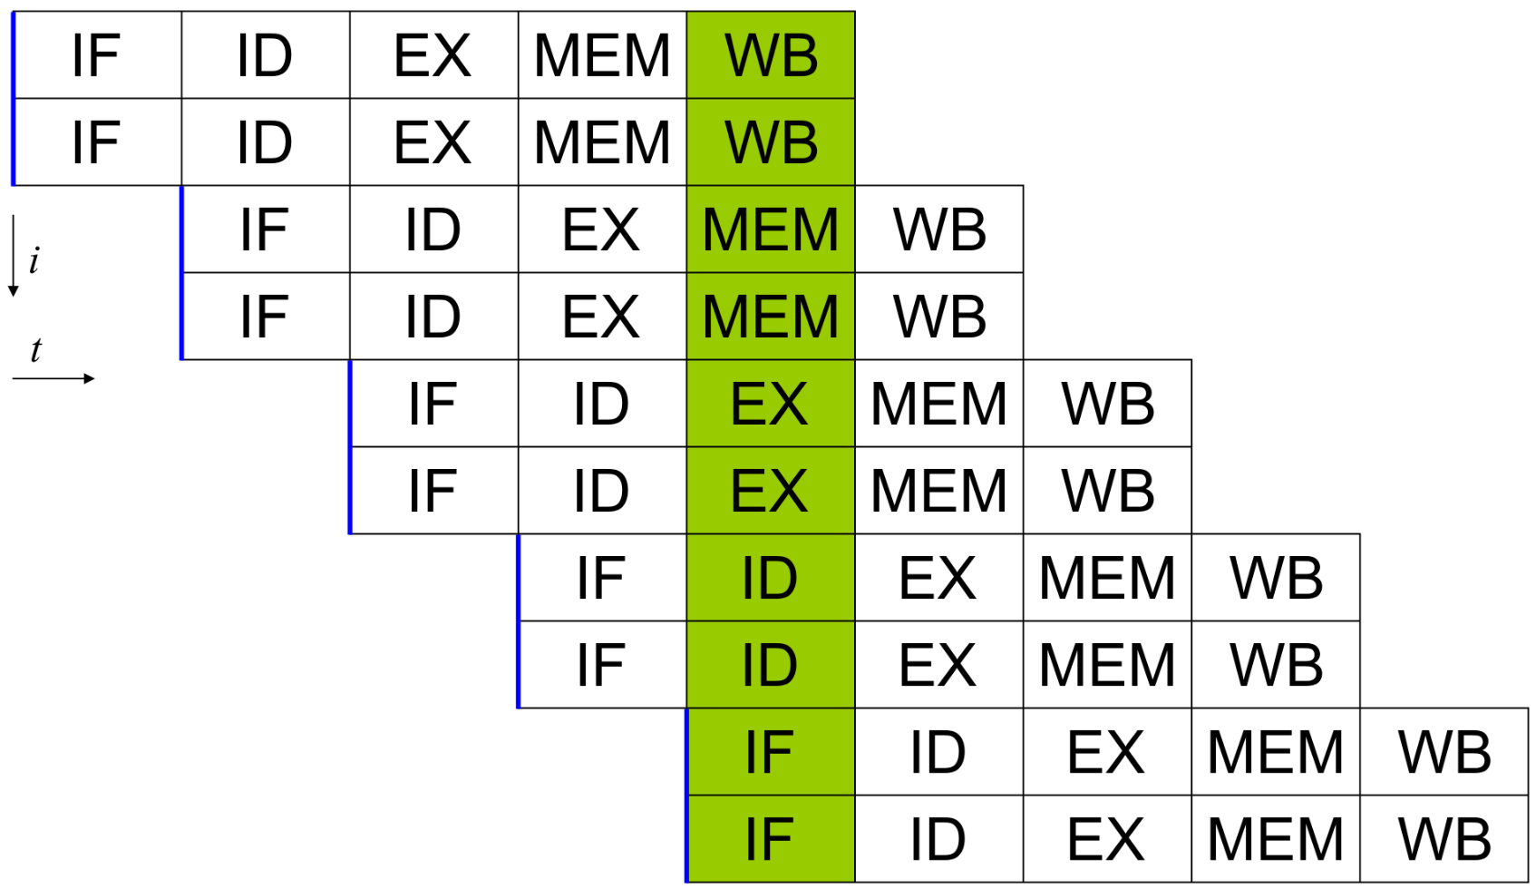
Instruction Level Parallelism (2)
Pipelining - functional units are arranged in stages.
Multiple issue - multiple instructions can be simultaneously initiated.

Slide 38


Pipelining

Slide 39
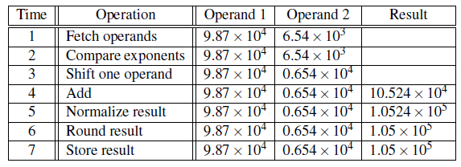
Pipelining example (1)
Add the floating point numbers 9.87×10⁴ and 6.54×10³

Slide 40
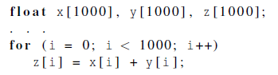
Pipelining example (2)
Assume each stage takes 1 nanosecond (10⁻⁹ s).
This for loop takes about 7000 nanoseconds.

Slide 41
Pipelining (3)
Divide the floating point adder into 7 separate pieces of hardware or functional units.
First unit fetches two operands, second unit compares exponents, etc.
Output of one functional unit is input to the next.

Slide 42
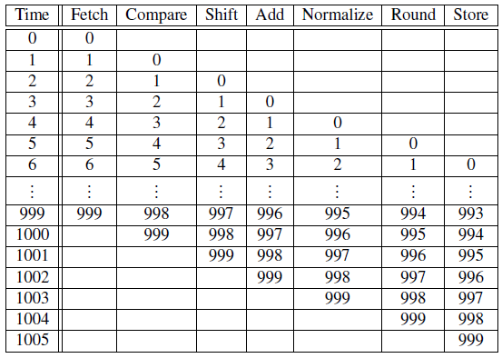
Pipelining (4)
Table 2.3: Pipelined Addition.
Numbers in the table are subscripts of operands/results.

Slide 43
Pipelining (5)
One floating point addition still takes 7 nanoseconds.
But 1000 floating point additions now takes 1006 nanoseconds!

Slide 44
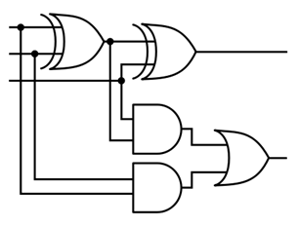
Multiple Issue (1)
Multiple issue processors replicate functional units and try to simultaneously execute different instructions in a program.
for (i = 0; i < 1000; i++)
z[i] = x[i] + y[i];
z[3]
z[4]
z[1]
z[2]
adder #1
adder #2

Slide 45
Multiple Issue (2)
static multiple issue - functional units are scheduled at compile time.
dynamic multiple issue – functional units are scheduled at run-time.
superscalar

Slide 46
Speculation (1)
In order to make use of multiple issue, the system must find instructions that can be executed simultaneously.
In speculation, the compiler or the processor makes a guess about an instruction, and then executes the instruction on the basis of the guess.

Slide 47
Speculation (2)
z = x + y ;
i f ( z > 0)
w = x ;
e l s e
w = y ;
Z will be
positive
If the system speculates incorrectly,
it must go back and recalculate w = y.

Slide 48
Hardware multithreading (1)
There aren’t always good opportunities for simultaneous execution of different threads.
Hardware multithreading provides a means for systems to continue doing useful work when the task being currently executed has stalled.
Ex., the current task has to wait for data to be loaded from memory.

Slide 49
Hardware multithreading (2)
Fine-grained - the processor switches between threads after each instruction, skipping threads that are stalled.
Pros: potential to avoid wasted machine time due to stalls.
Cons: a thread that’s ready to execute a long sequence of instructions may have to wait to execute every instruction.

Slide 50
Hardware multithreading (3)
Coarse-grained - only switches threads that are stalled waiting for a time-consuming operation to complete.
Pros: switching threads doesn’t need to be nearly instantaneous.
Cons: the processor can be idled on shorter stalls, and thread switching will also cause delays.

Slide 51
Hardware multithreading (3)
Simultaneous multithreading (SMT) - a variation on fine-grained multithreading.
Allows multiple threads to make use of the multiple functional units.

Slide 52
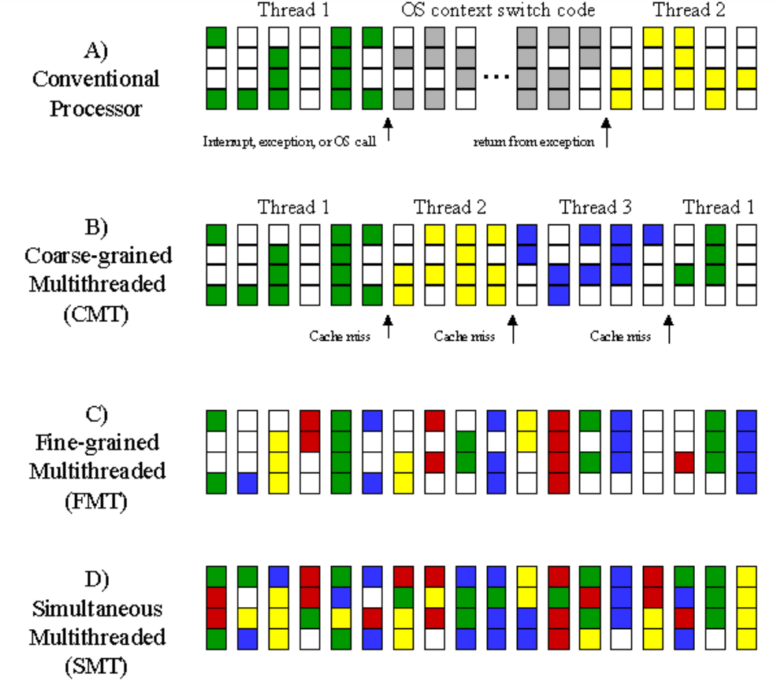

Slide 53
Program, Process, Thread

Slide 54
Program vs. Process
A program is the code that is stored on your computer that is intended to fulfill a certain task.
There can be multiple instances of a single program, and each instance of that running program is a process.
Each process has a separate memory address space, which means that a process runs independently and is isolated from other processes.
https://www.backblaze.com/blog/whats-the-diff-programs-processes-and-threads/
Notes:
https://www.backblaze.com/blog/whats-the-diff-programs-processes-and-threads/

Slide 55
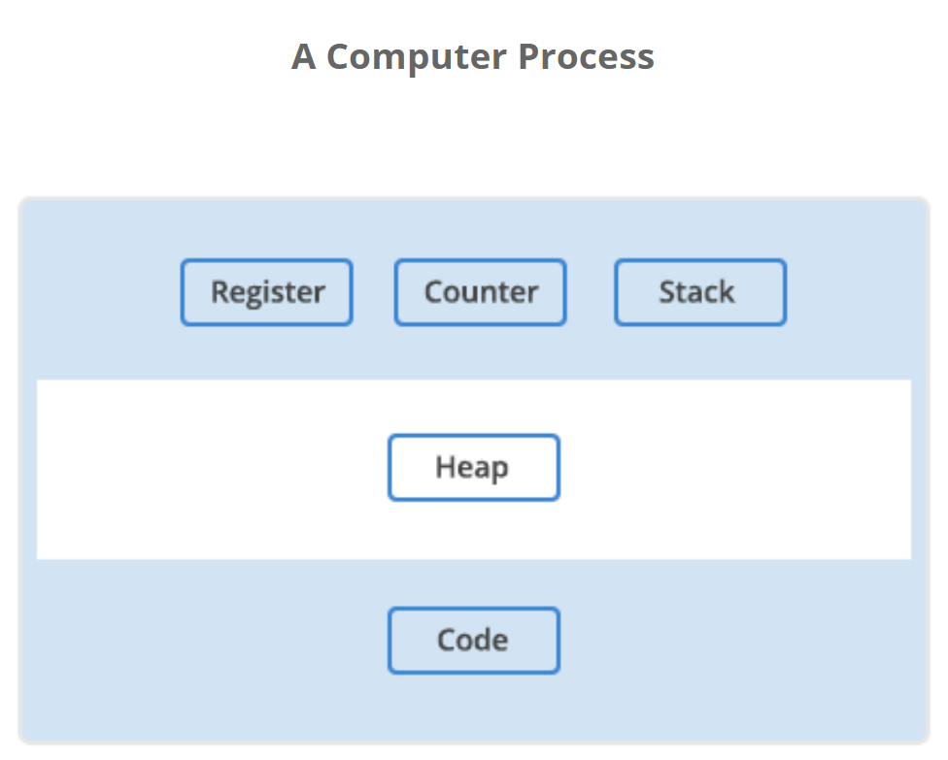
Each process has a separate memory address space, which means that a process runs independently and is isolated from other processes. It cannot directly access shared data in other processes.
Switching from one process to another requires some time (relatively) for saving and loading registers, memory maps, and other resources.

Slide 56
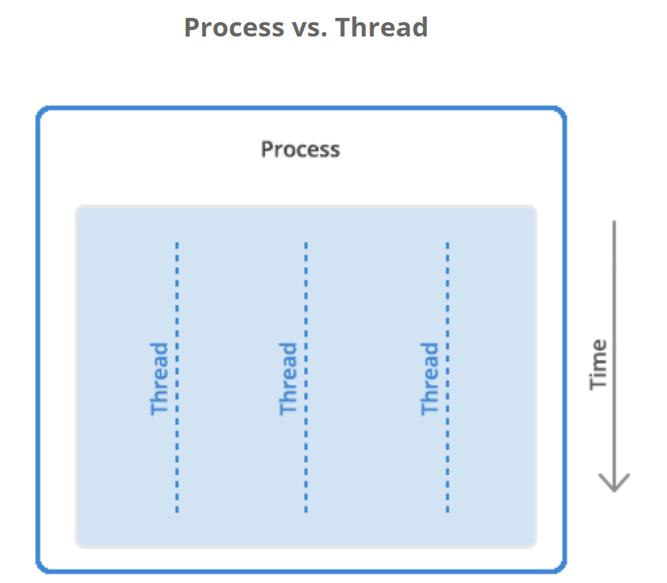
Process vs. Thread
A thread is the unit of execution within a process.
A process can have 1~n threads.

Slide 57
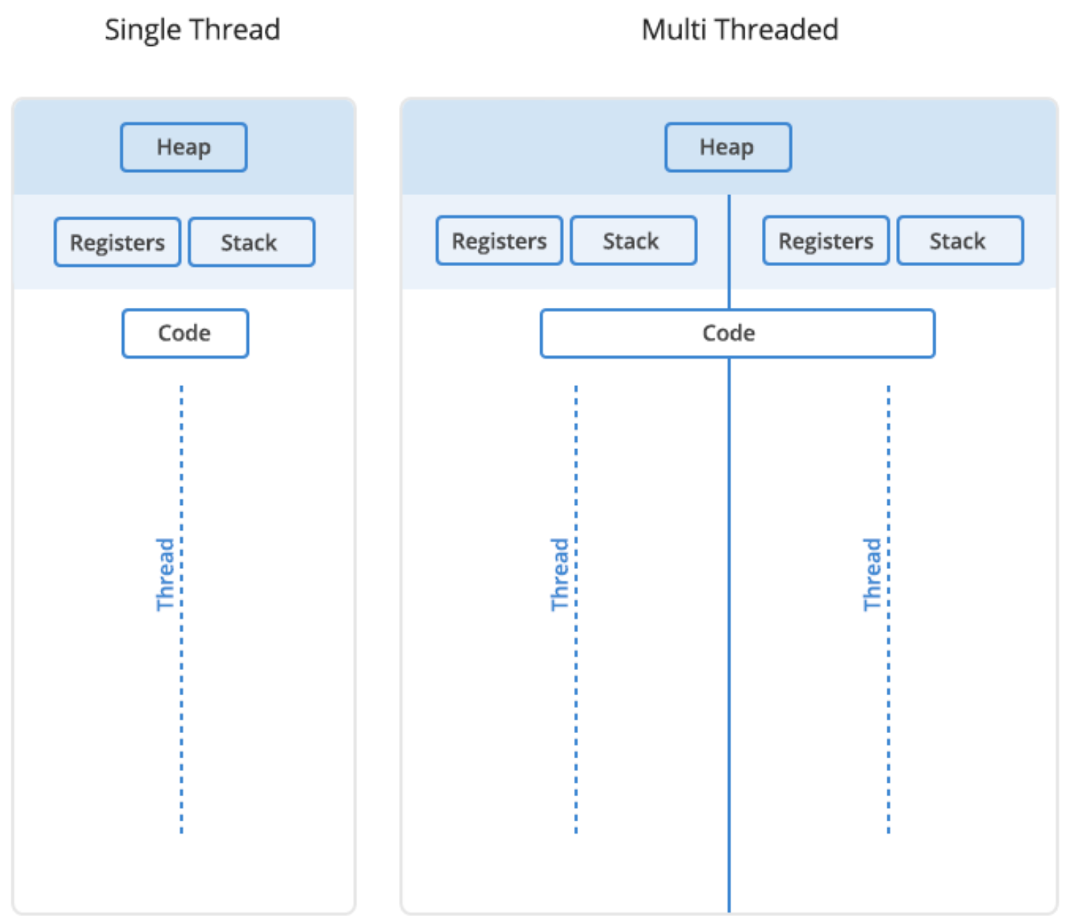
Each thread will have its own stack, but all the threads in a process will share the heap.
A problem with one thread in a process will certainly affect other threads and the viability of the process itself.

Slide 58
Things to review
The program starts out as a text file of programming code,
The program is compiled or interpreted into binary form,
The program is loaded into memory,
The program becomes one or more running processes.
Processes are typically independent of each other,
While threads exist as the subset of a process.
Threads can communicate with each other more easily than processes can
But threads are more vulnerable to problems caused by other threads in the same process.

Slide 59
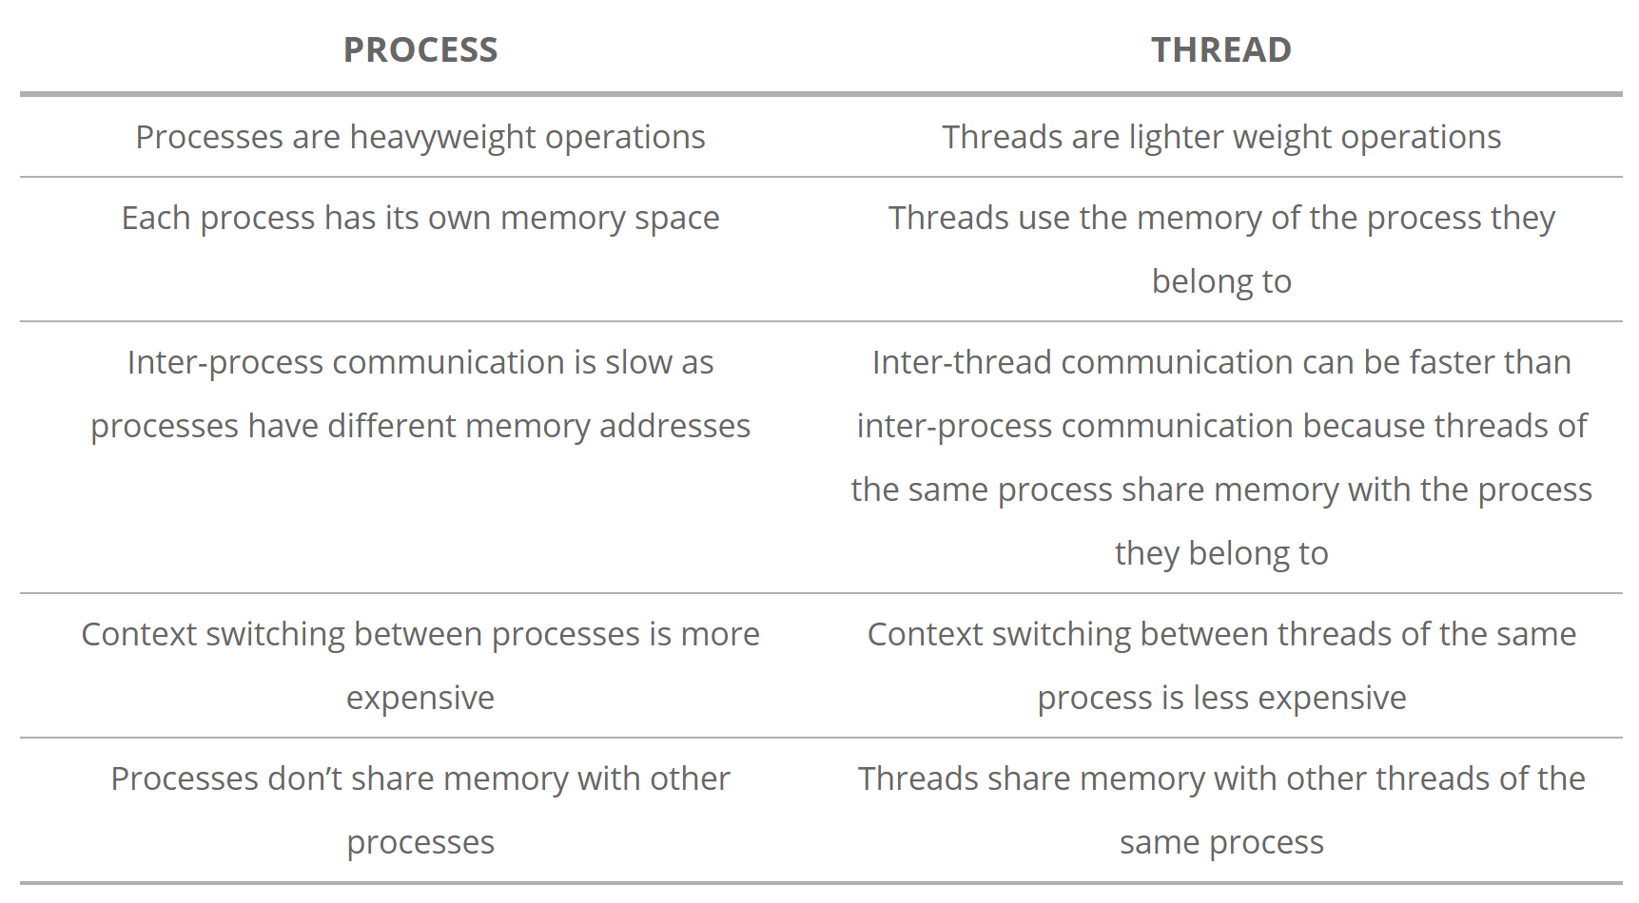
Processes vs. Threads — Advantages and Disadvantages

Slide 60
CPU, Core, Processor

Slide 61
CPU vs. Core
A core is usually the basic computation unit of the CPU
it can run a single program context
or multiple ones if it supports hardware threads such as hyperthreading on Intel CPUs
A CPU may have one or more cores to perform tasks at a given time.
These tasks are usually software processes and threads that the OS schedules.
X = number cores * number of hardware threads per core.
Notes:
https://superuser.com/questions/1041370/definition-of-a-processor-vs-core-multiprocessor-vs-multicore

Slide 62
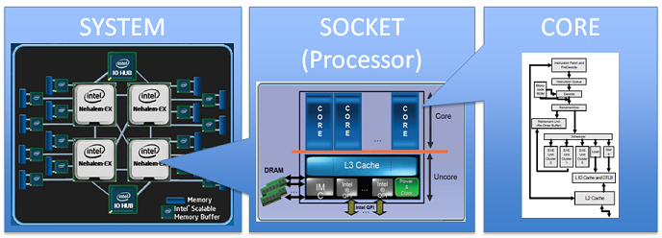
CPU vs. Core
A CPU contains (1-many) cores.
Each core can execute (1-many) threads depending on hyper-threading technology
Notes:
https://stackoverflow.com/questions/19225859/difference-between-core-and-processor

Slide 63
Processor vs. CPU
A processor is a generic term used to describe any sort of CPU, regardless of cores.
A multiprocessor system contains more than one CPU, allowing them to work in parallel.
This is called SMP, or Symmetric Multi-Processing.
A multicore CPU has multiple cores on one CPU.

Slide 64
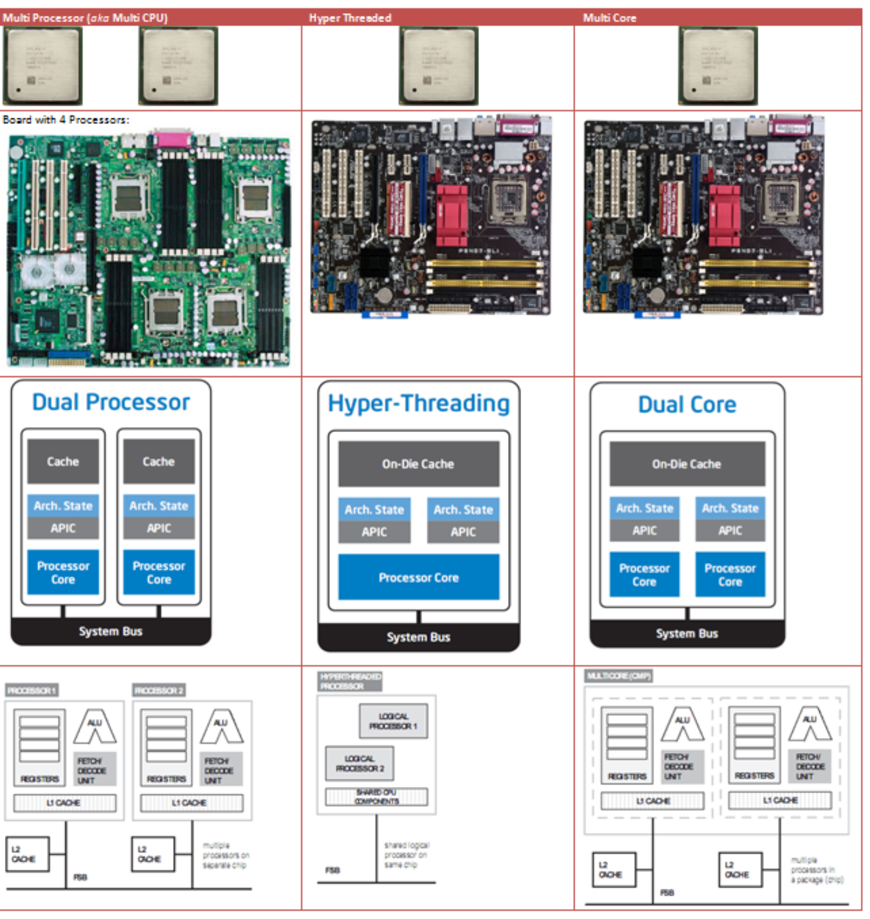
Multi-processor
Single-core CPU
Multi-Core CPU

Slide 65
Can a single process run in multiple cores?
Yes, a single process can run multiple threads on different cores.
Notes:
https://stackoverflow.com/questions/38733670/can-a-single-process-run-in-multiple-cores

Slide 66
Can a single thread run in multiple cores?
There is no such thing as a single thread running on multiple cores simultaneously.
Thread migration is possible
It doesn't mean, however, that instructions from one thread cannot be executed in parallel.
There are mechanisms called instruction pipelining and out-of-order execution that allow it.

Slide 67
Concurrent vs. Parallel

Slide 68
Concurrent vs. Parallel
A system is said to be concurrent if it can support two or more actions in progress at the same time.
A system is said to be parallel if it can support two or more actions executing simultaneously.
Notes:
https://stackoverflow.com/questions/1897993/what-is-the-difference-between-concurrent-programming-and-parallel-programming

Slide 69
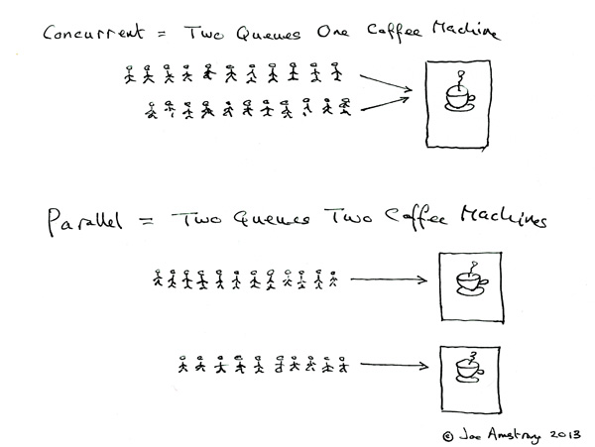
Concurrent = Two queues and one coffee machine.
Parallel = Two queues and two coffee machines.
in progress at the same time.
Executing simultaneously

Slide 70
Parallel Computing vs. Concurrent Computing
In parallel computing, execution occurs at the same physical instant
parallel computing is impossible on a (one-core) single processor
concurrent computing consists of process lifetimes overlapping, but execution need not happen at the same instant
concurrent processes can be executed on one core by interleaving the execution steps of each process via time-sharing slices
https://en.wikipedia.org/wiki/Parallel_computing

Slide 71
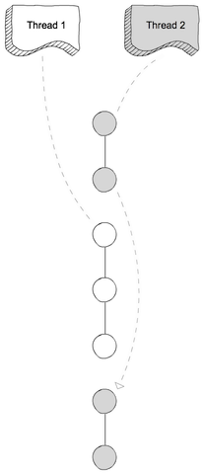
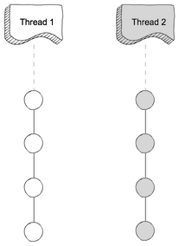
Concurrent Computing
Parallel Computing

Slide 72
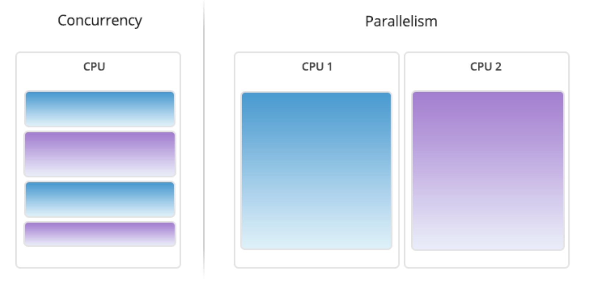

Slide 73
Supplementary materials

Slide 74
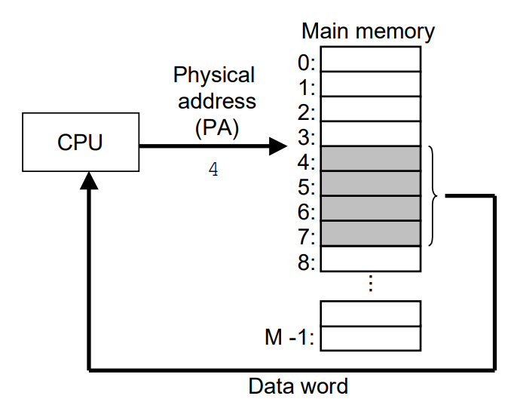
A system that uses physical addressing
Notes:
Source: https://csapp.cs.cmu.edu/2e/ch9-preview.pdf

Slide 75
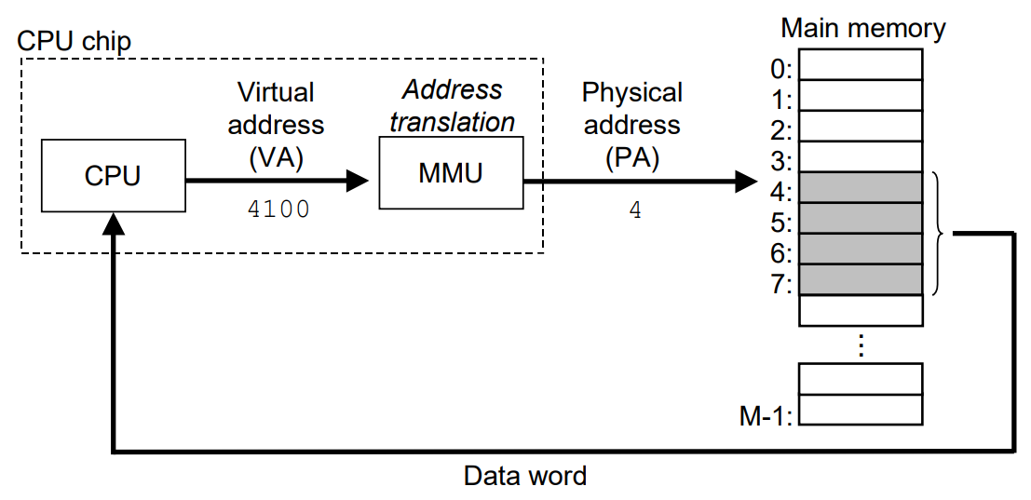
A system that uses virtual addressing
Dedicated hardware on the CPU chip called the memory management unit (MMU) translates virtual addresses on the fly, using a look-up table stored in main memory whose contents are managed by the operating system.
back

Slide 76
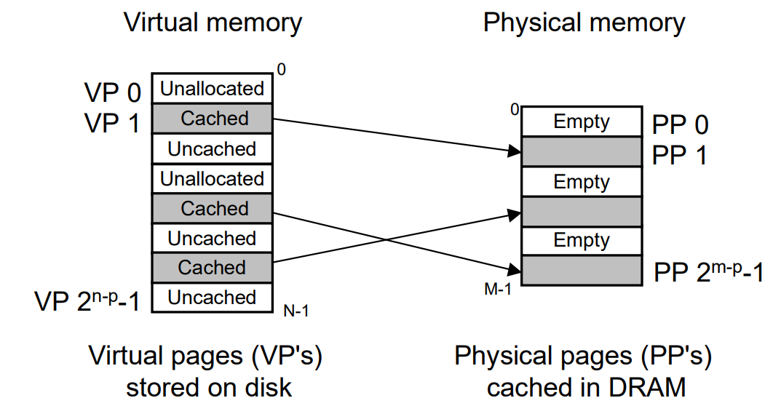
How a VM system uses main memory as a cache
partitioning the virtual memory into fixed-sized blocks called virtual pages (VPs)
Similarly, physical memory is partitioned into physical pages (PPs) / page frame
Each page is P = 2^p bytes in size

Slide 77
How a VM system uses main memory as a cache
Unallocated: Pages that have not yet been allocated (or created) by the VM system. Unallocated blocks do not have any data associated with them, and thus do not occupy any space on disk.
Cached: Allocated pages that are currently cached in physical memory
Uncached: Allocated pages that are not cached in physical memory.
back

Slide 78
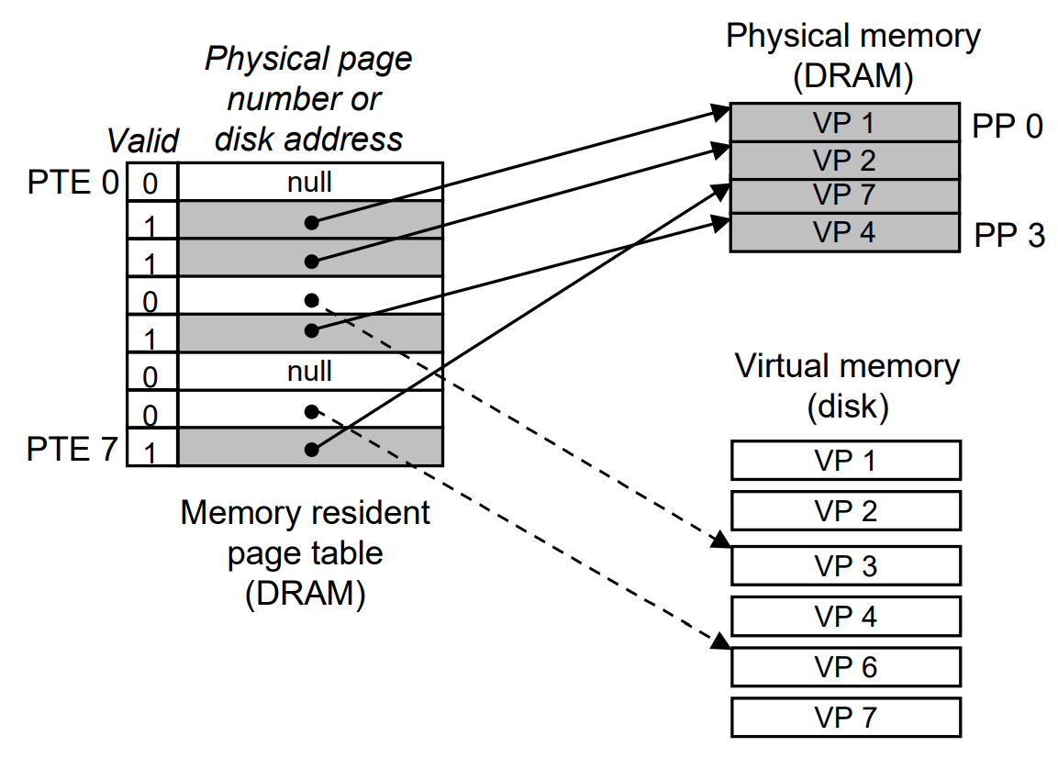
Page table
A page table is an array of page table entries (PTEs)
Each PTE consists of a valid bit and an n-bit address field
back

